Slide 1
Alternative charts considered for Insights on Riots/Protests in India
Information Visualization Project
Group H (Robinson, Pavithra, Ashfaqur )

Slide 2
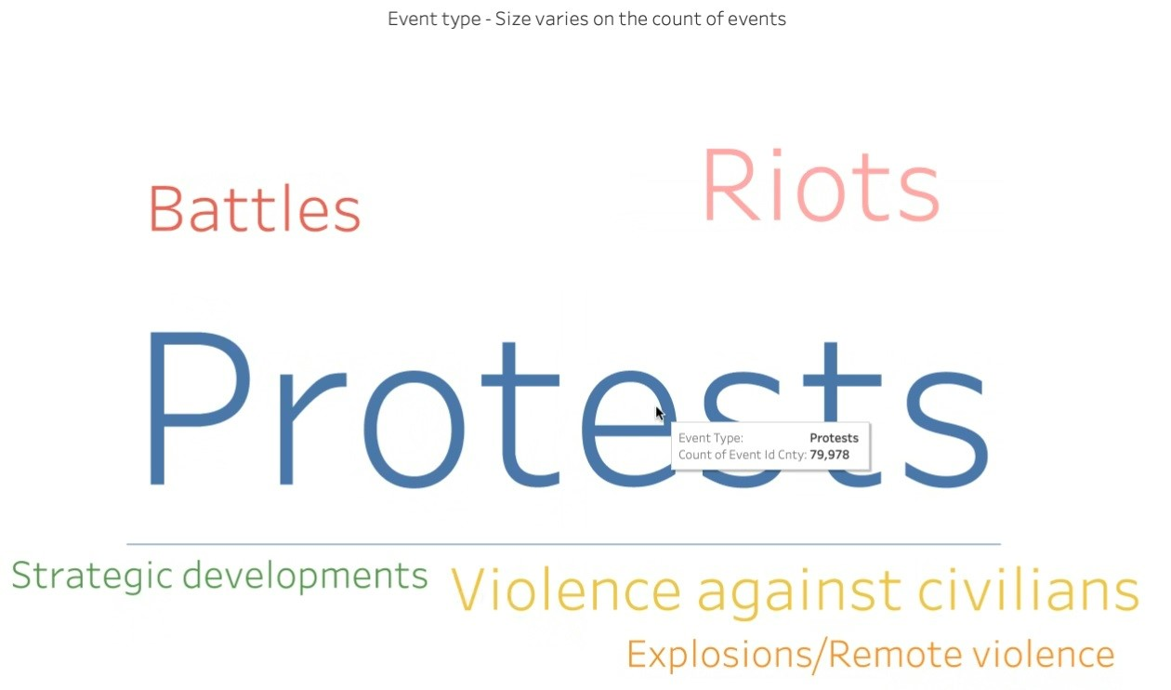
Word Cloud for type of events

Slide 3
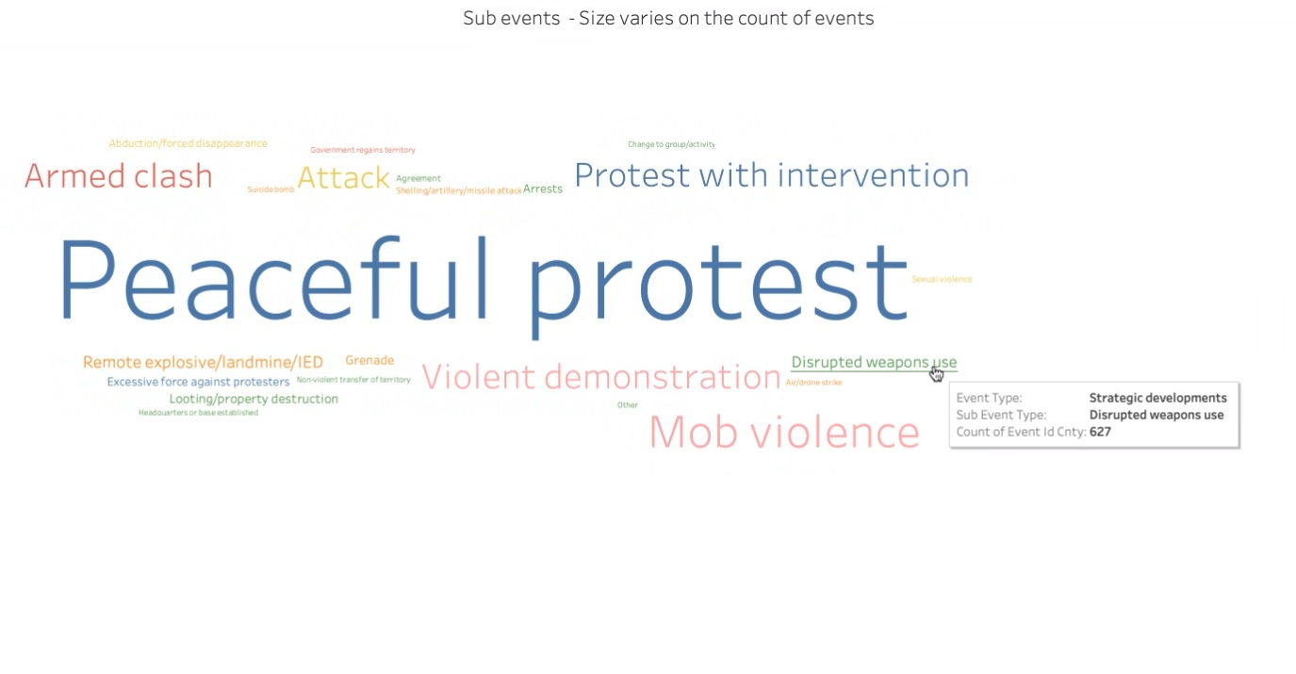
Word Cloud for type of Sub-events

Slide 4
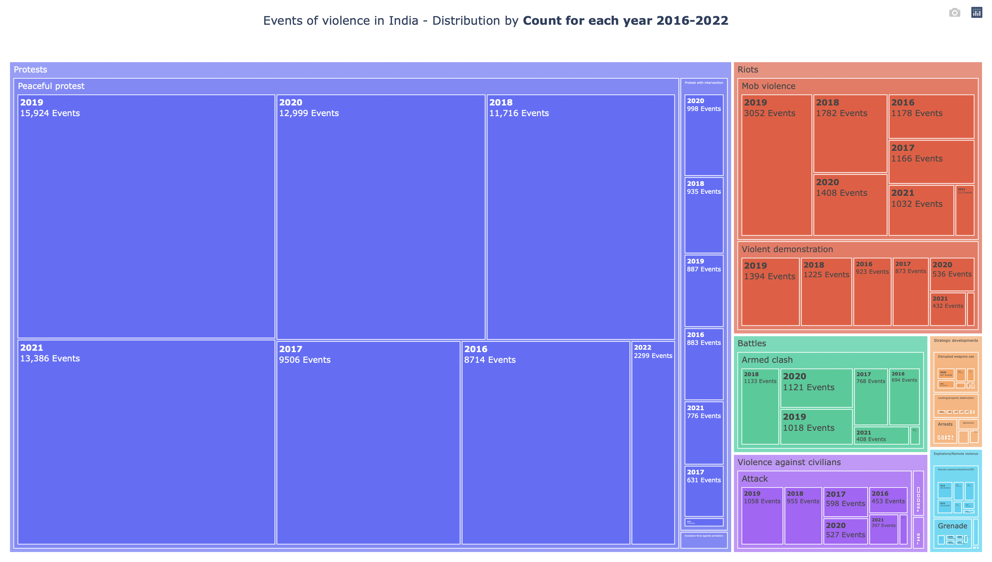
Year wise split-up of events and sub events

Slide 5
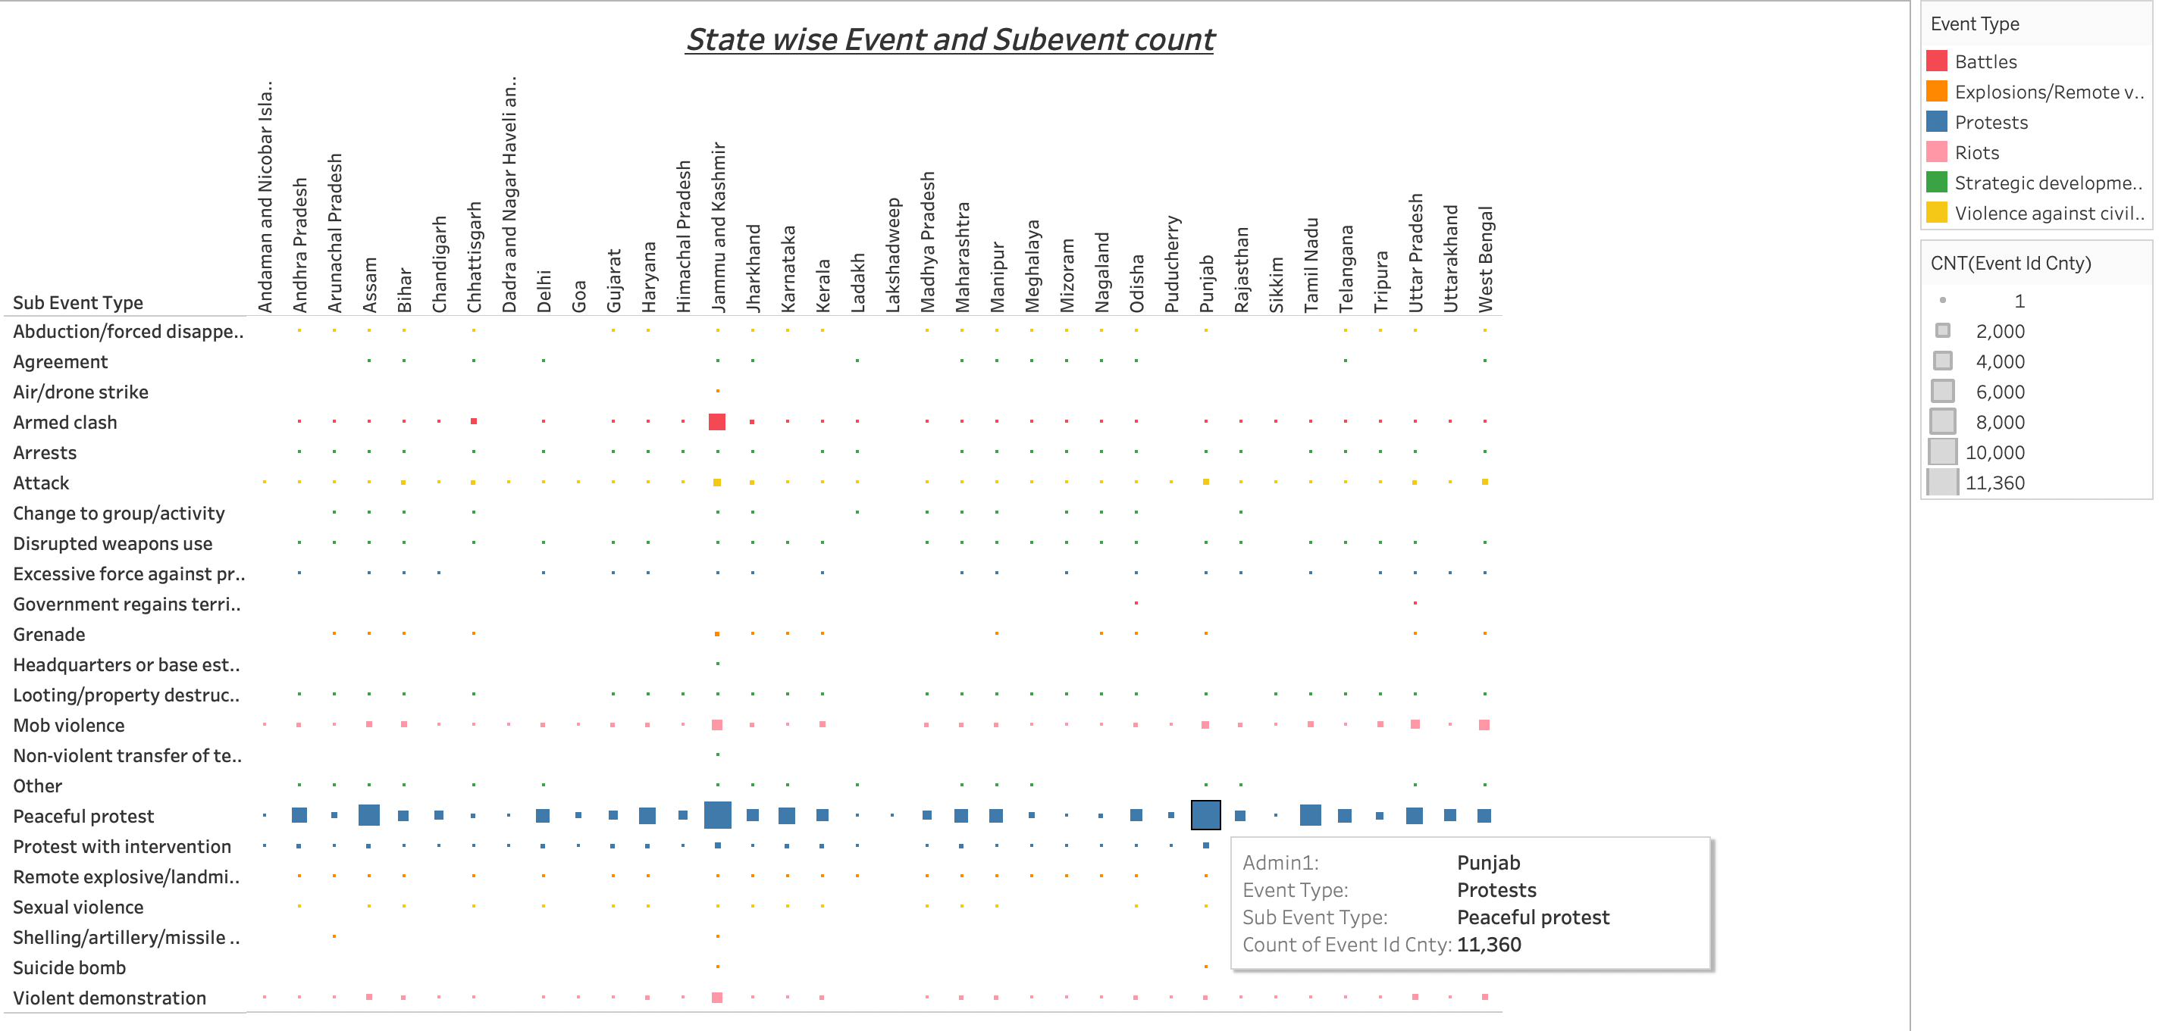
State wise event and sub event comparison
The number of events (color) and sub-events (column on the left-side) that took place in each state

Slide 6
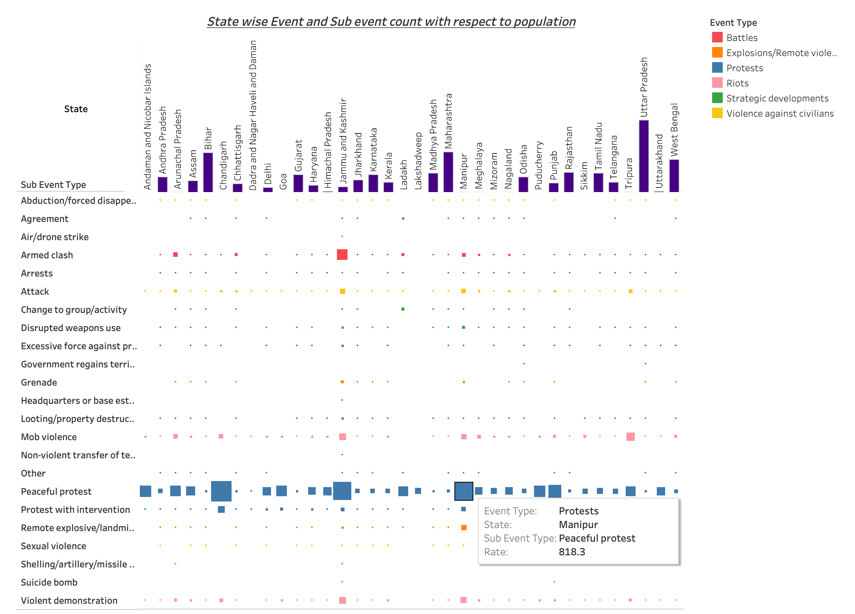
State wise event and sub event with respect to population
The number of events (color) and sub-events (column on the left-side) that took place in each state considering the population of each state. The population data we took it from Wikipedia and merged into the existing table using Oracle.
Rate Calculation = round(Total_numbers/(population/1000000),5)

Slide 7
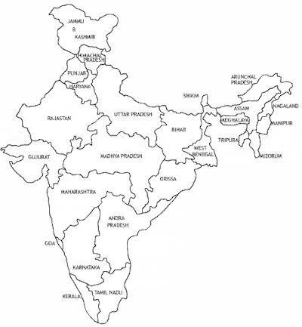
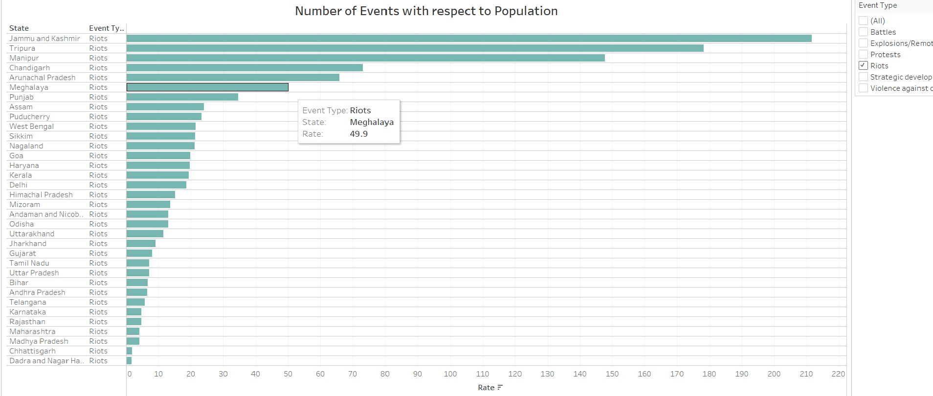
Number of Riots in States
When we filter Riots and sort it we can see that out of Top 6, the four states are North-Eastern states which are Tripura, Manipur, Arunachal Pradesh, Meghalaya and the other one is Jammu and Kashmir which has different kind of issue and the exception is Chandigarh.

Slide 8
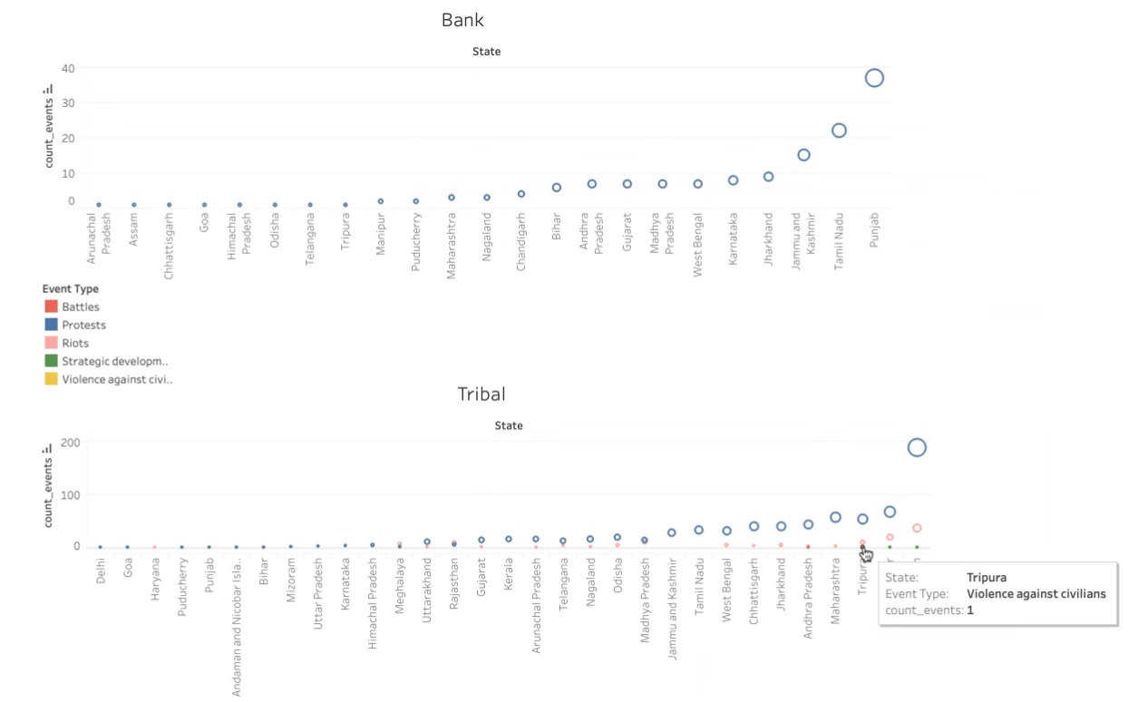
Events carried out by Bank workers and Tribal people
If we look at the events carried out by Bank workers it is only protest but whereas if we look at the events which involve tribal people there are Riots and Violence against civilians.

Slide 9
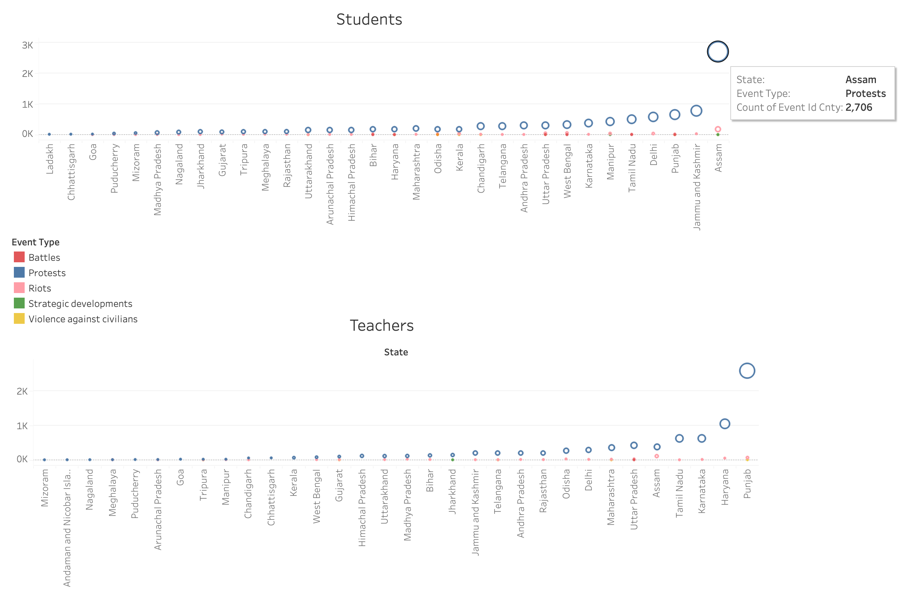
Events carried out by Students and Teachers

Slide 10
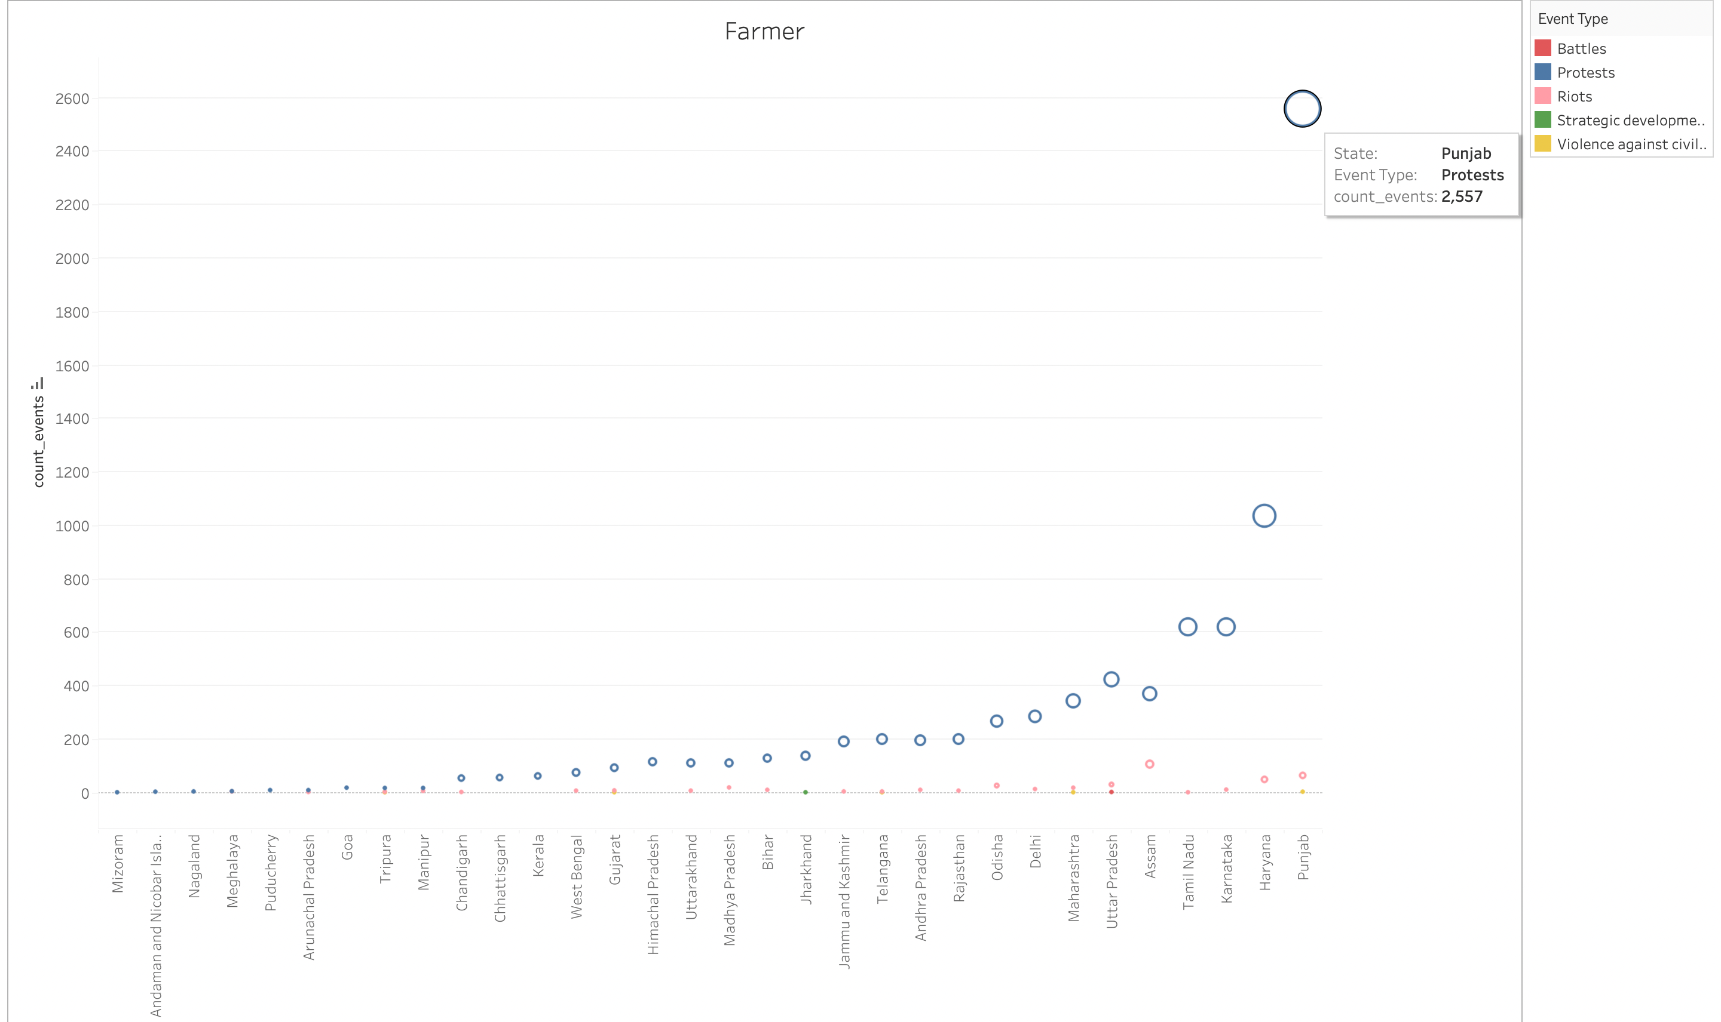
Events carried out by Farmers
If we look at the top 5 states in which the student, teacher and farmer involved in a event they are Punjab, Assam and Tamil Nadu which doesn’t have any relation but we can understand that they are vocal and being active for their rights.

Slide 11
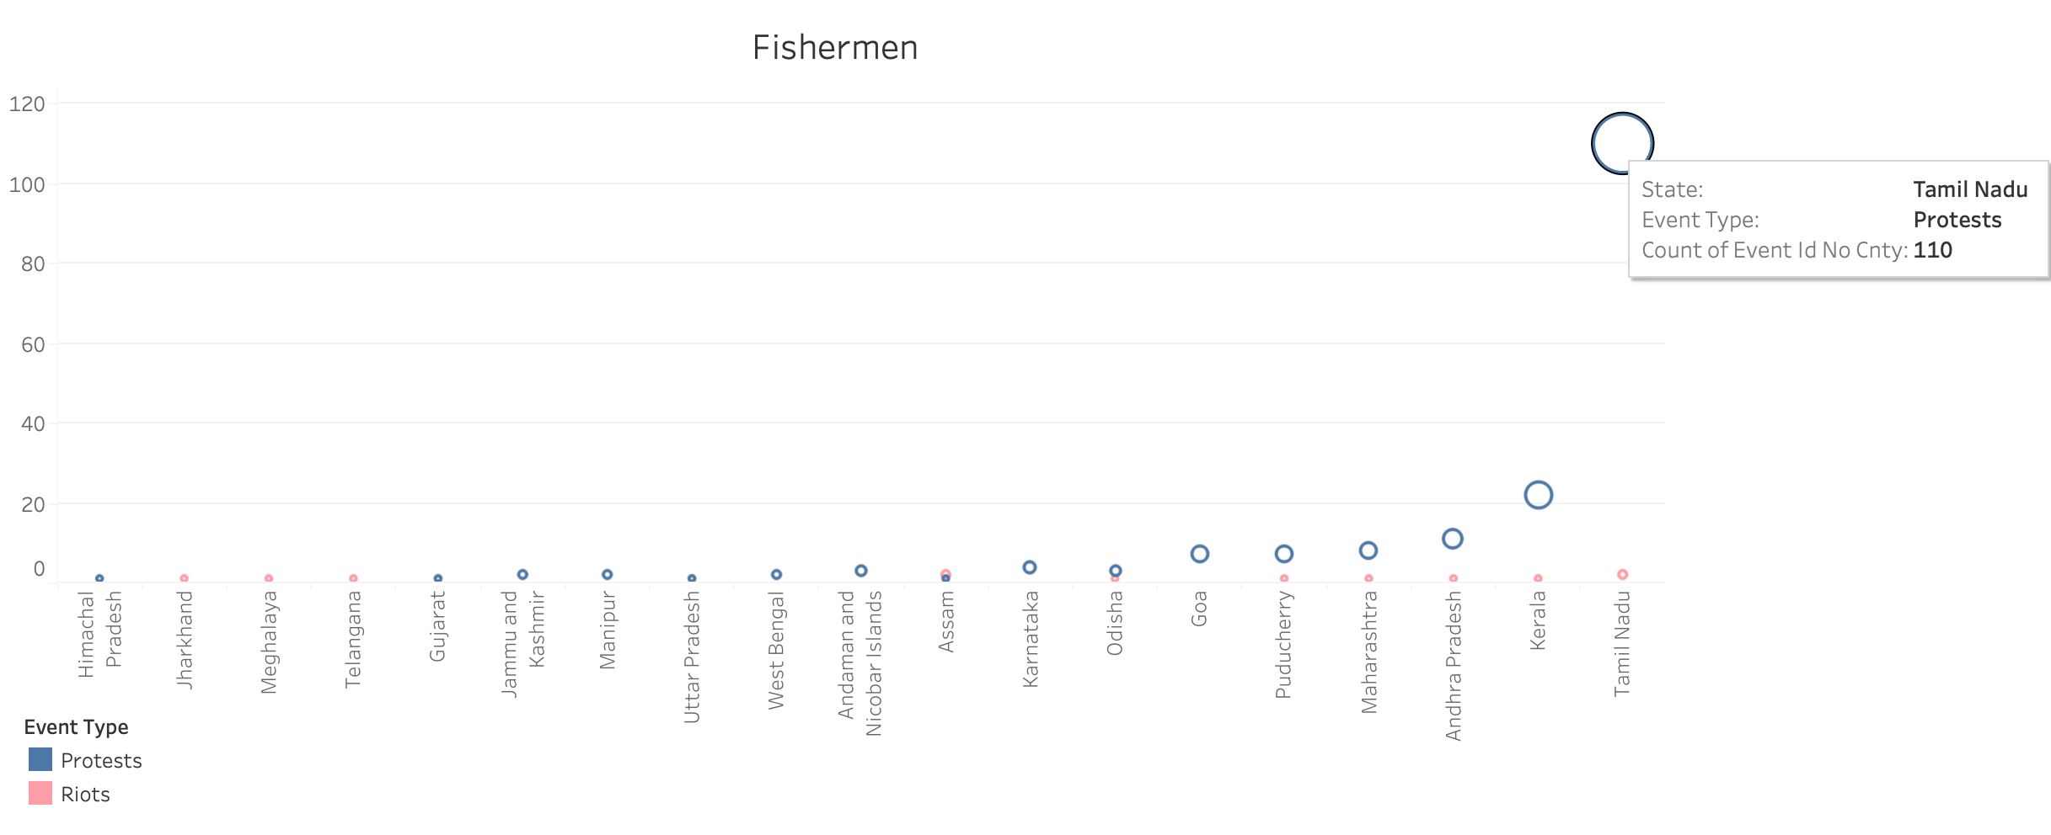
Events carried out by Fishermen
The difference between the maximum count 110 of Tamil Nadu and the second maximum count 22 of kerala is huge which says that there are lot of issues that needs to be addressed for Tamil Nadu Fisherman.

Slide 12
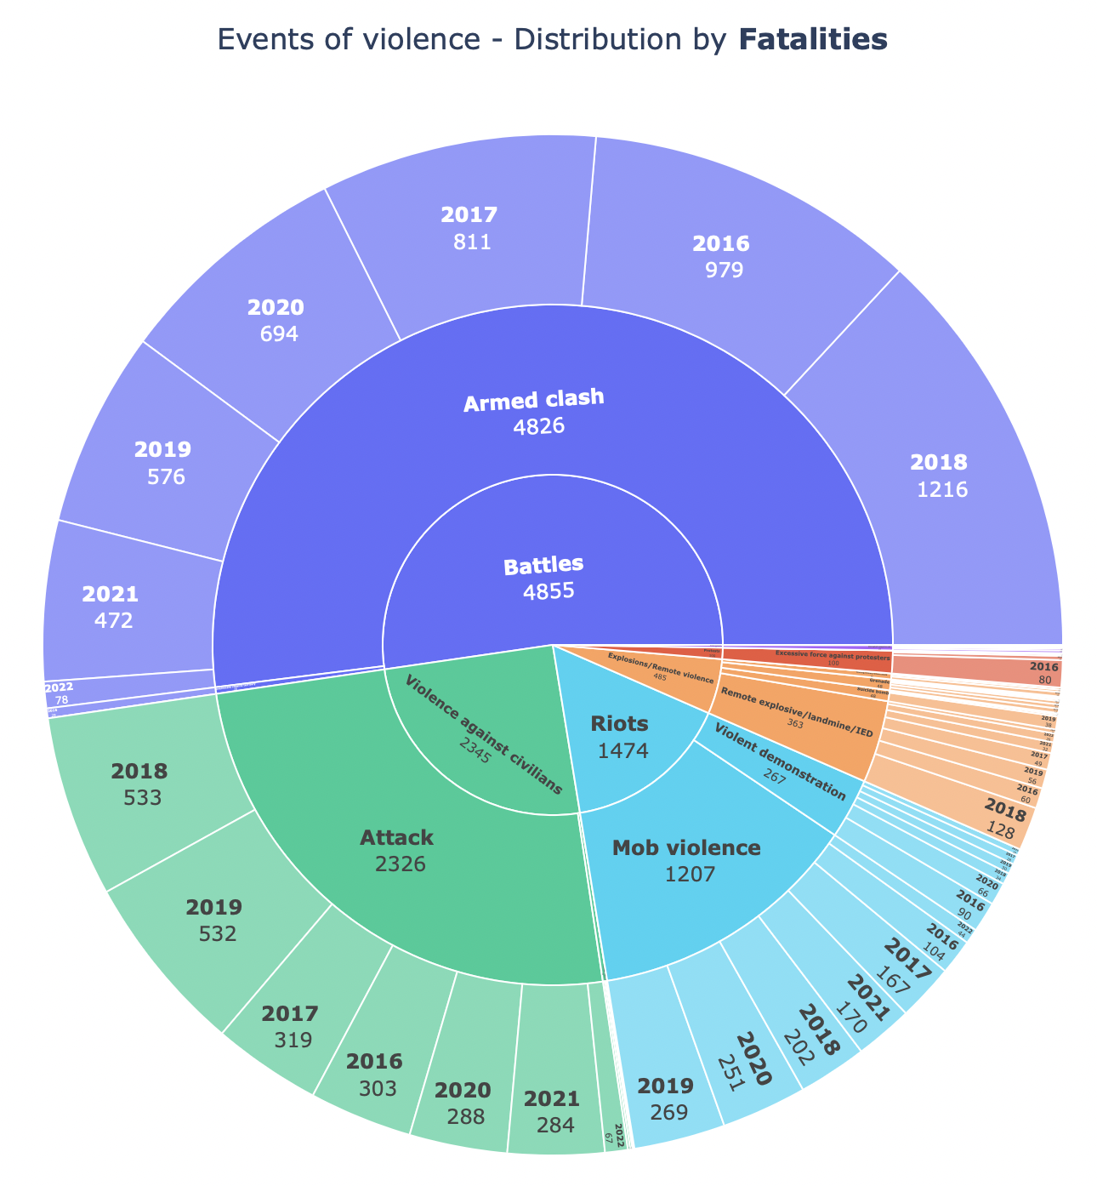
No of Fatalities with respect to Events, Sub Events, Year
This is a sun-burst chart that give details about the number of fatalities for events, sub-events and year

Slide 13
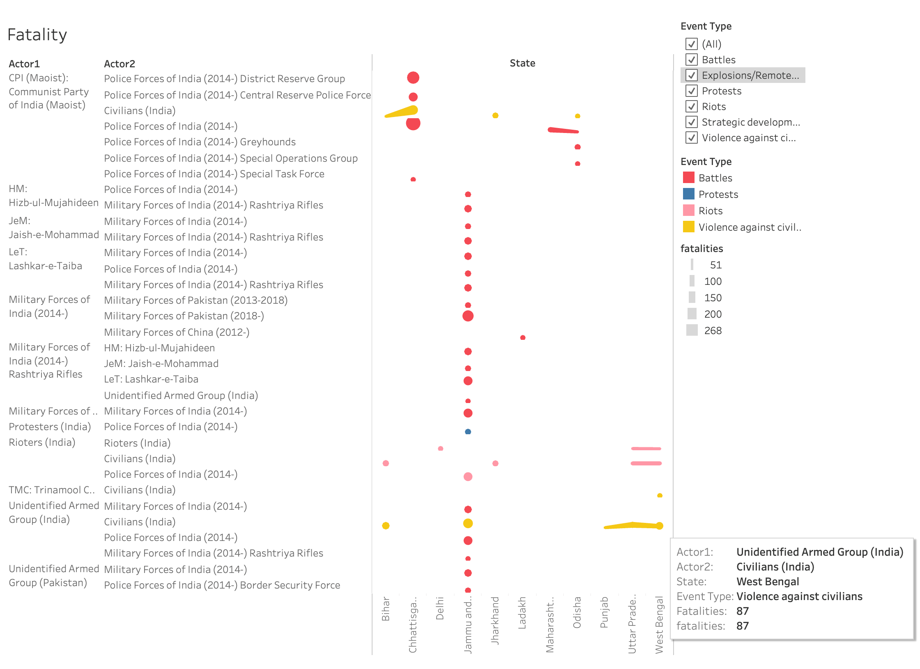
Fatalities with respect to Actor1 and Actor2
This chart shows for which two actors the fatality rate is high across the states. The fatality rate is taken from minimum of 50.

Slide 14
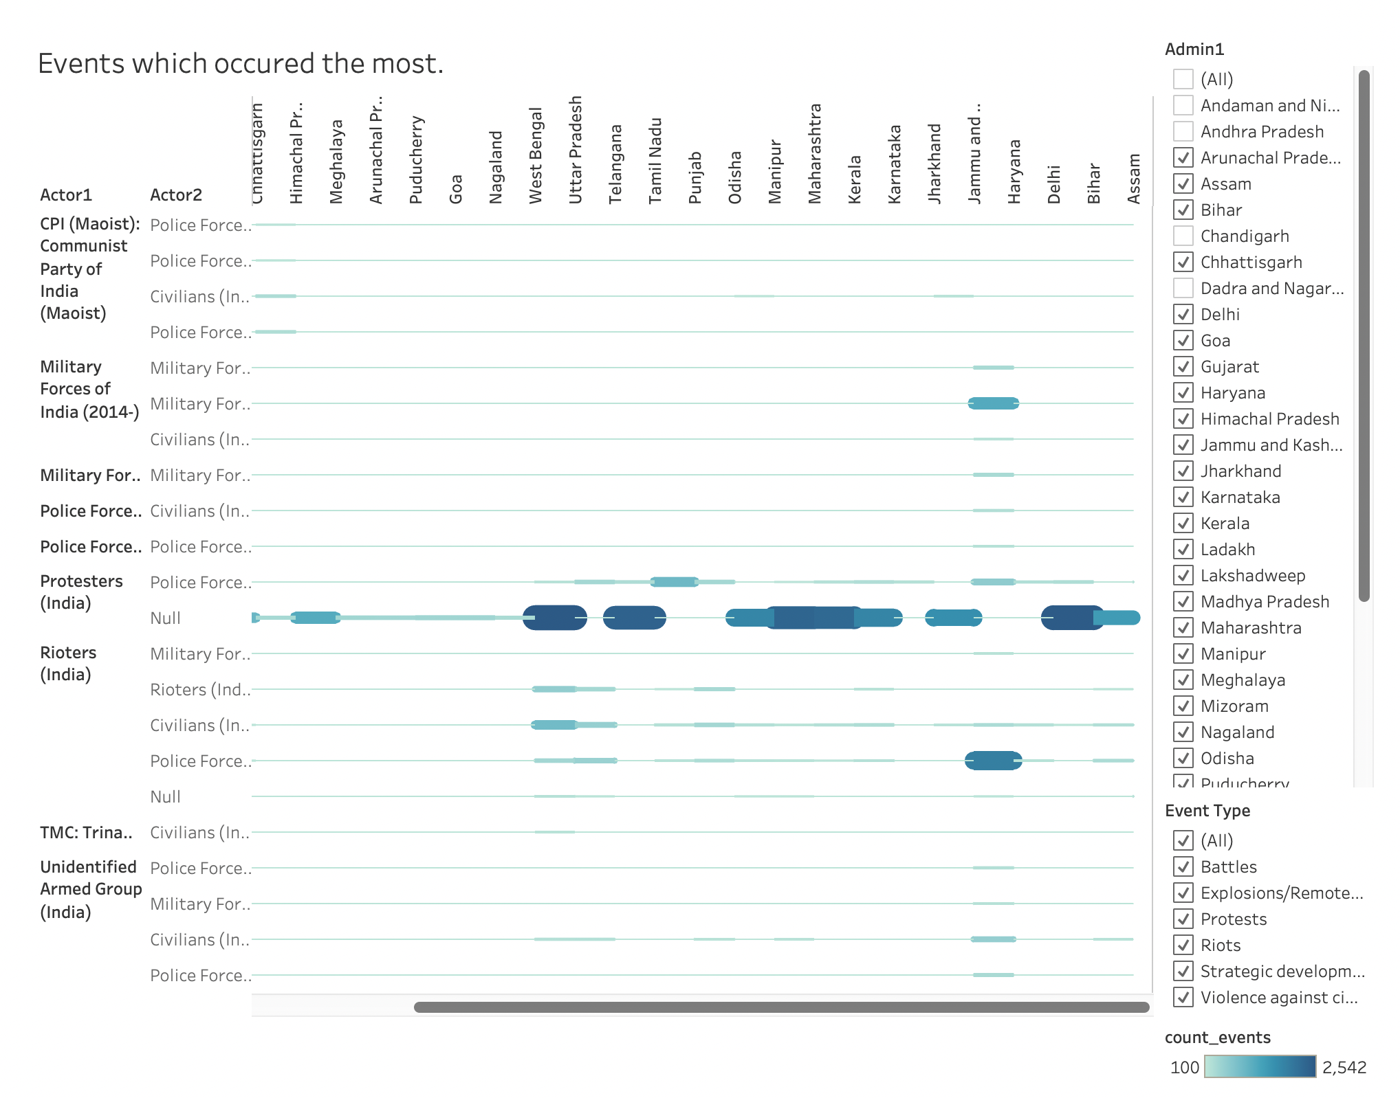
Events which occurred the most between Actor1 and Actor2
This chart shows for which two actors the Event numbers is high across the states. The fatality rate is taken from minimum of 100.

Slide 15
Thank you!

